Slide 1


Internship
Payrot Yohann

Slide 2
Summary :
The company
The team
Project PCGC
My work
Conclusion

Slide 3
The group La Poste
1
5
7
6
1 march 2010
23th
250 000 employees
22 billion

Slide 4
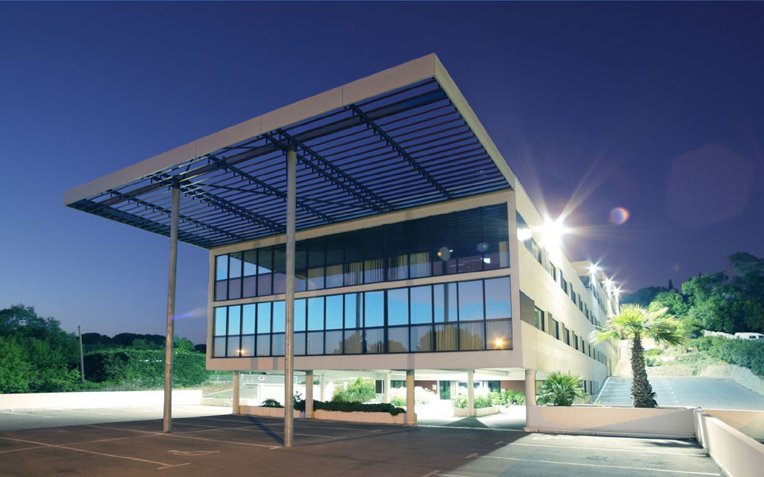
La DSI-C
Address :
796 rue de la Croix de Lavit 34000
Site http://www.laposte.fr/

Slide 5
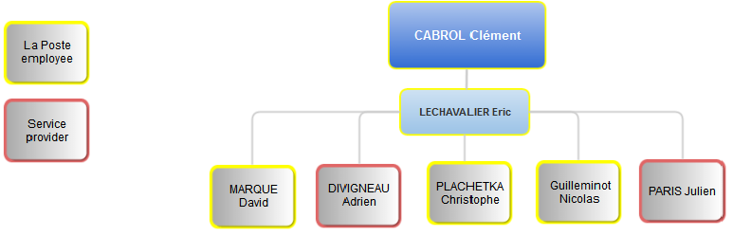
L’équipe

Slide 6

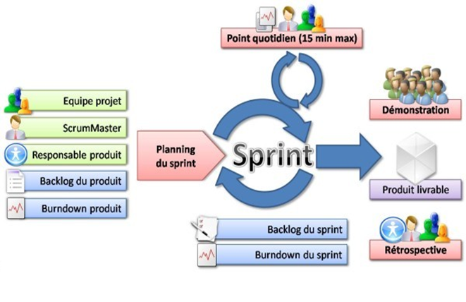
Work method

Slide 7
Project PCGC
Portal Key Accounts :
500 users of various financial groups.
More than 110 major accounts concerned.
1 Key Account is a customer who reported more than 10 million turnover

Slide 8
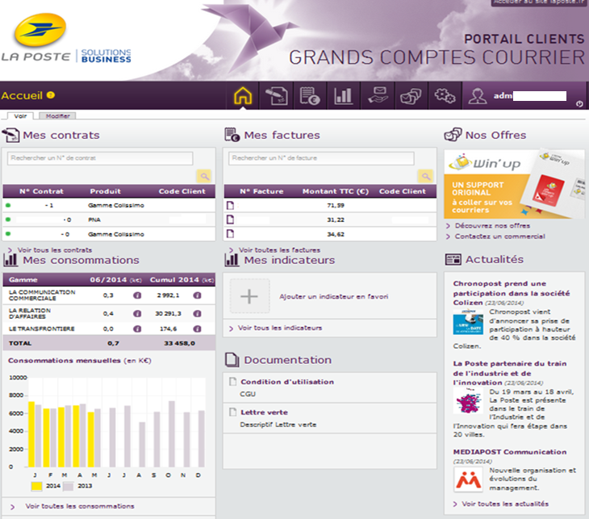

Slide 9




Technologies

Slide 10
Completed projects
Block « Documentation ».
Updating the Back-Office.
Changing the type of financial group.
Export CSV consumption.

Slide 11
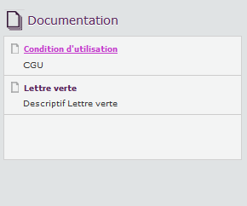
Block Documentation
Creating a block « Documentation »
Creating a document type
Upload documents
Display according to the sectors
A counter of uploaded documents
issues :
Environment Drupal
Limiting the size of the upload
maintainable code
Taxonomy (Sectors of activity)

Slide 12
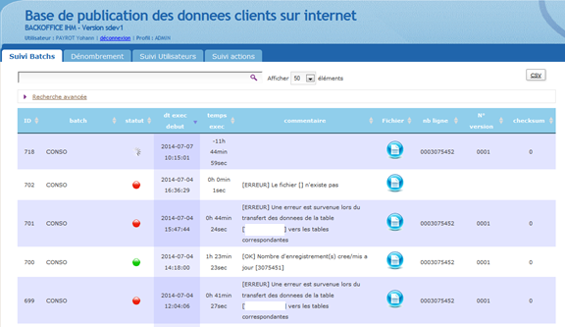
Updating the Back-Office
Creating a batch
Update the interface
Checking / changing
Issues:
Concept of Batch unknown
Working on an unknown environment
maintainable code

Slide 13
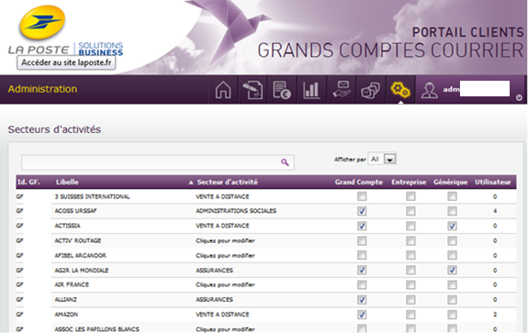
Modification of the type of financial group
Administration function to change the type of a financial group.
- Number of users on the
financial Group
Issues :
Asynchronous (Ajax)
Oracle

Slide 14
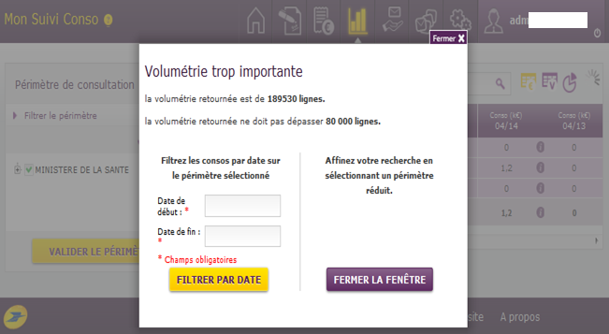
Export CSV consumption
issues :
Response time.
complex queries.
Ajax
Export of consumption of customers.
- If the volume of consumption is too high, a standing filter is carried out.
- Search Refine consumption.
- Export to CSV

Slide 15
Conclusion
- Positive experience
- Strong background in web development
- Design and Conduct of a project
Relevance to my career
- Discover the reality of a large company.
- autonomy.
- New knowledge.
- Agile method.

Slide 16
Thank you
ANY QUESTIONS ?

